Slide 1
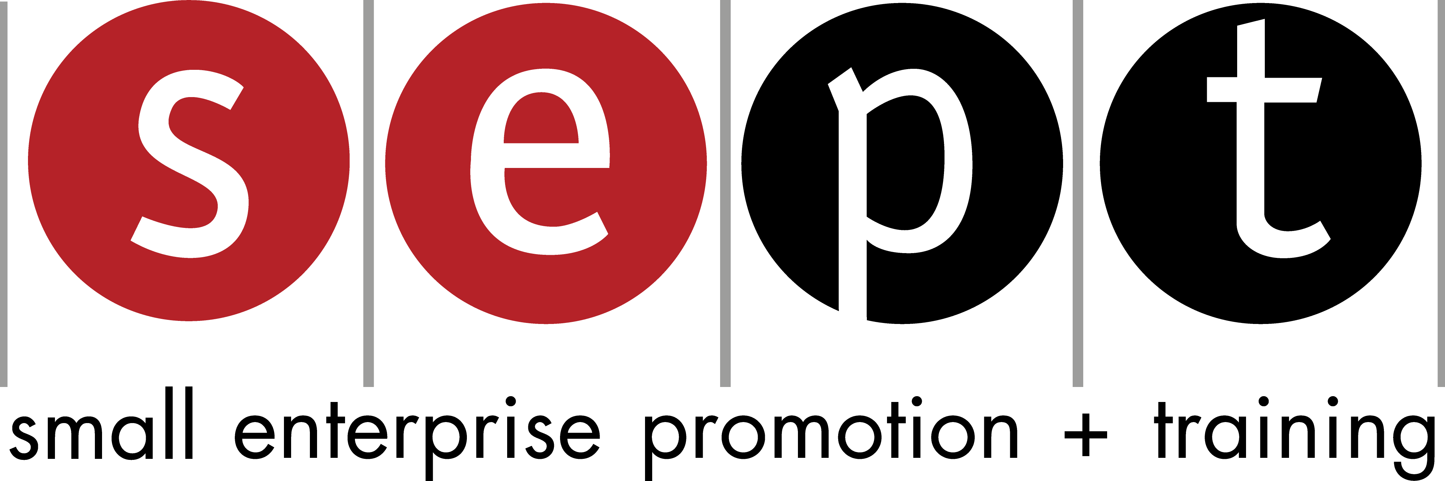

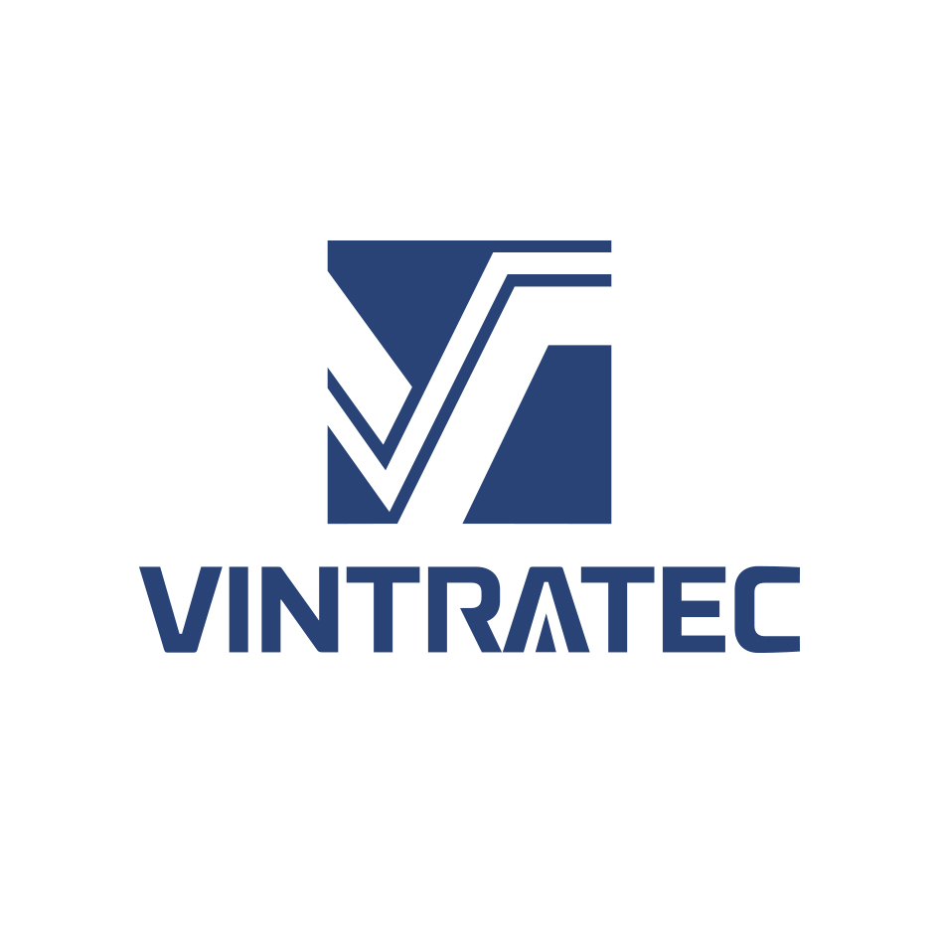
VINTRATEC
VIETNAM TRADE TECHNOLOGY ENGINEERING JOINT STOCK COMPANY
Presenter: Ms. Thi Huong Nguyen, huongnguyenthi@tlu.edu.vn
Alumni International conference: Development Cooperation in Times of Multiple Crisis
"
Notes:
It is my pleasure to introduce to you VINTRATEC, also known as Vietnam Trade Technology Engineering Joint Stock Company.

Slide 2
Challenges and opportunities
- Established in 2009
- Fields: Technology solution, Installation and maintenance of automation systems, …
- Authorized capital: ~380.000 USD Revenue 2021: ~830.000 USD
- Number of core employees: 4 Revenue 2022: ~1,5 m USD
VUCA, Pandemic Covid19
Cutting operating costs
Some fixed costs → variable costs (e.g. office rents, salaries).
optimizing cost structure and management functions
  Outsourcing
  Focusing in the strength
Notes:
Established in 2009, VINTRATEC is currently providing technology solutions, installation and maintenance services for automation systems.
With an authorized capital of approximately 380,000 USD, VINTRATEC has demonstrated financial stability and commitment to excellence. Our company is proud of our dedicated team of four core employees who are the driving force behind our success.
Faced with countless challenges, VINTRATEC has demonstrated its resilience and adaptability. We have had to make changes in a volatile business environment.
To overcome these challenges, we have taken proactive measures to reduce operating costs and optimize our cost structure and management functions. For example, we converted certain fixed costs, such as office rent and salaries, into variable costs.
Amidst the challenges, VINTRATEC sees opportunities ahead. We see potential in outsourcing certain functions, which allows us to leverage external expertise and focus on our core strengths.
Optimizing our cost structure and management functions opens new avenues for growth and ensures that we remain agile and competitive in the market.
In 2021, VINTRATEC achieved revenue of about 830,000 USD, and our company had significant growth in 2022, with revenue of about 1.5 million USD.

Slide 3
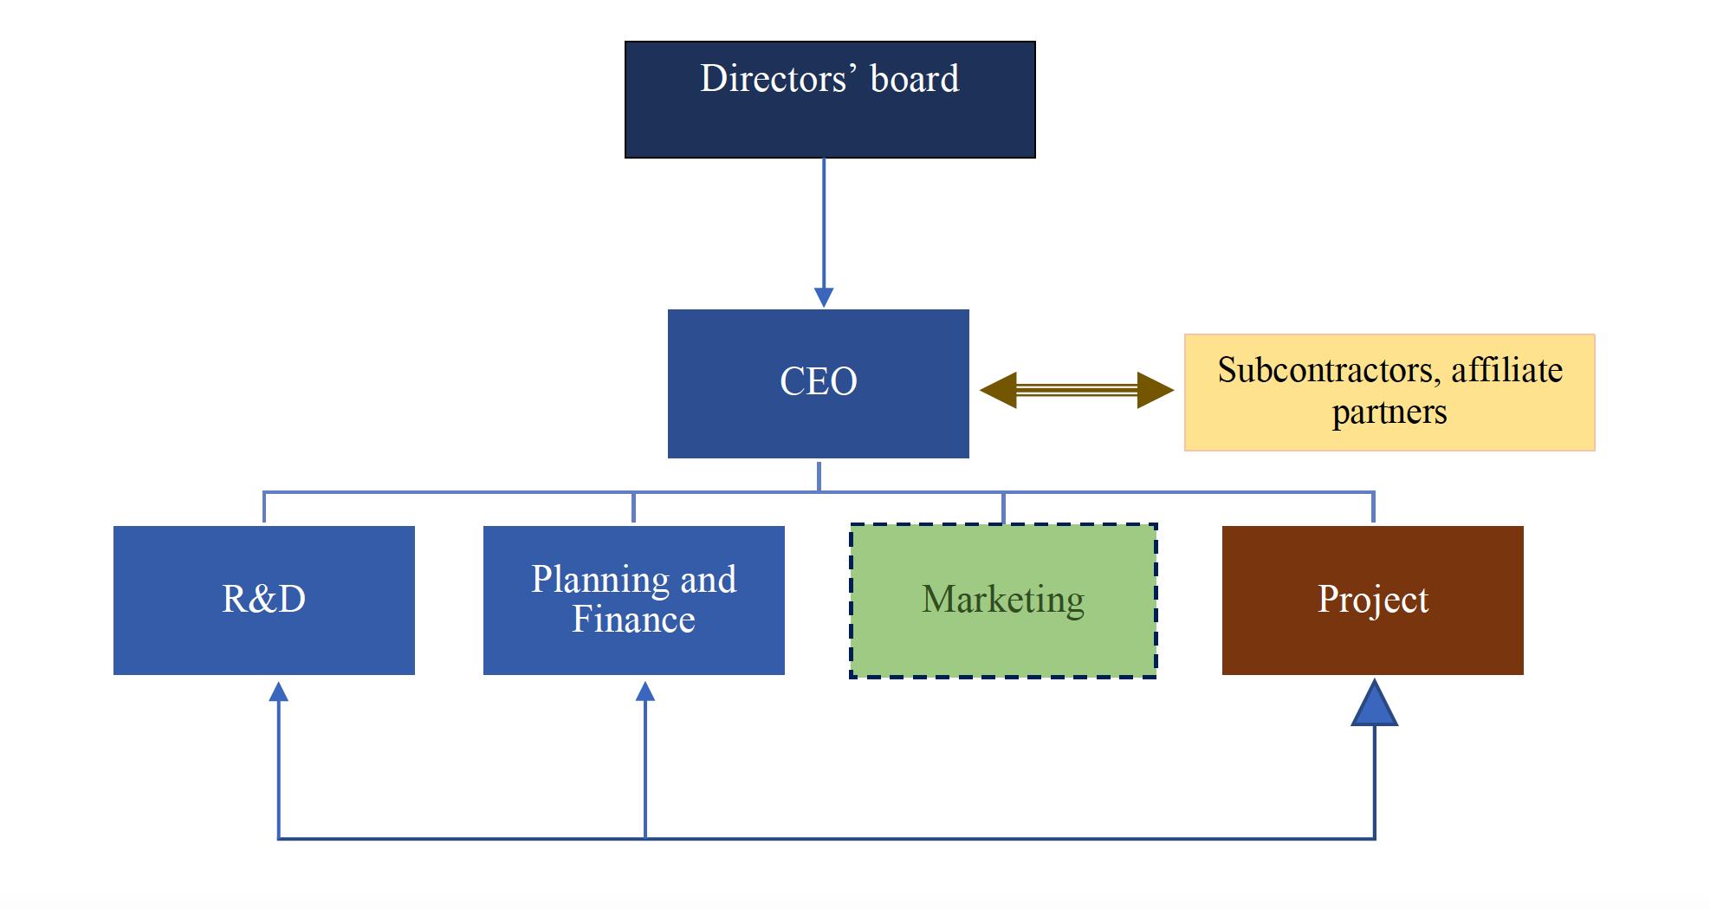
Phase 1: Project construction
Phase 2: Project bidding
Phase 3: Implementating the winning project
Cooperation with subcontractors, affiliate partners

Slide 4
Results
Optimizing cost structure: Revenue: equipments 40%, operating and other costs 40-45%, income after tax 15-20%
Optimizing management functions: Flexible business model, working processes and management reforming
Less staff, more qualified, more committed, multitasked and higher paid
Sharing opportunities and risks with partners for sustainable development
Co-branding, good reputation
More flexible in dealing with multiple crises in the future
Notes:
Results of Optimizing Management Function, Costs, and Enhancing External Cooperation:
Optimizing Cost Structure:
- Revenue Distribution: The optimization process resulted in a revenue structure where equipment sales contribute 40% of the total revenue.
- Operating and Other Costs: Through effective cost management, operating and other costs have been optimized to range between 40% and 45% of total costs.
- Income After Tax: The optimization efforts have led to an improved financial performance, with income after tax ranging between 15% and 20% of the total revenue.
Optimizing Management Functions:
- Flexible Business Model: The company has successfully implemented a flexible business model, allowing it to adapt swiftly to changing market conditions and customer demands.
- Working Process and Management Reform: The optimization process involved revamping working processes and implementing management reforms. This has led to streamlined operations, increased efficiency, and improved decision-making capabilities.
- Staffing Optimization: The company has focused on retaining a smaller but highly qualified and dedicated workforce. This has resulted in a more committed team that can handle multiple tasks, contributing to increased productivity.
- Competitive Wages: To attract and retain top talent, the company has raised its salary levels, ensuring that employees are fairly compensated for their skills and commitment.
- Sharing Opportunities and Risks: The company has fostered strategic partnerships, allowing for the sharing of opportunities and risks. This collaborative approach promotes sustainable development and enhances the company's competitive advantage.
- Co-Branding and Reputation: By engaging in co-branding initiatives and maintaining a good reputation, the company has improved its market position and customer perception. This has led to increased trust and loyalty among customers and stakeholders.
- Crisis Management: The optimization efforts have made the company more agile and adaptable, enabling it to effectively deal with multiple crises in the future. The organization has implemented robust contingency plans and response mechanisms to mitigate risks and maintain business continuity.
Overall, the optimization of management functions, cost structure, and external cooperation has resulted in improved financial performance, increased operational efficiency, enhanced reputation, and strengthened resilience in the face of future challenges. The company is better positioned to seize opportunities, mitigate risks, and achieve sustainable growth.

Slide 5


